Slide 1


AIONOS
AIONOS
Internal Service Agent
Assignment 2
Presented by:
Khushi Sharma 23csu159

Slide 2
AIONOS
BUILD AN INTERNAL EMPLOYEE-SUPPORT AGENT FOR ONE CORPORATE FUNCTION: IT, HR, OR FINANCE.
The agent should:
•Understand the employee's issue
•Find the relevant policy or resolution
•Ask sensible follow-up questions
•Resolve simple requests
•Escalate risky or unclear requests
•Create a structured ticket
•Show the source used for its answer
•Maintain an audit trail
Problem Statement -
Assignment 2

Slide 3
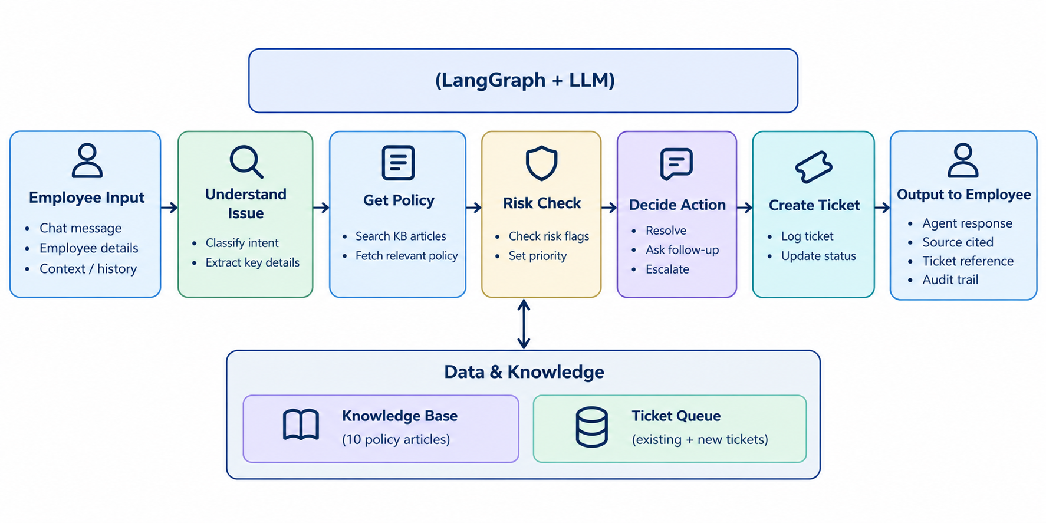
Architecture
AIONOS

Slide 4
  Python – Core backend & agent logic
  Streamlit – Interactive web interface
  LangGraph – Agent workflow orchestration
  Groq API – LLM inference
  GPT-OSS-120B – Language model
  Pandas – Ticket & request data handling
  python-dotenv – API key/configuration management
  Knowledge Base – Supplied data
AIONOS
Technology Stack

Slide 5


Ticketing & Audit Trail
AIONOS
01
Ticket
02
Audit trail
Understand issue
↓
Find policy
↓
Risk check
↓
Decision
↓
Create ticket
Each step records what happened and when.
Ticket ID
Employee
Category
Issue summary
KB sources cited
Risk flags
Action
Status
Priority
Response to employee
WWW.REALLYGREATSITE.COM
PAGE 13

Slide 6
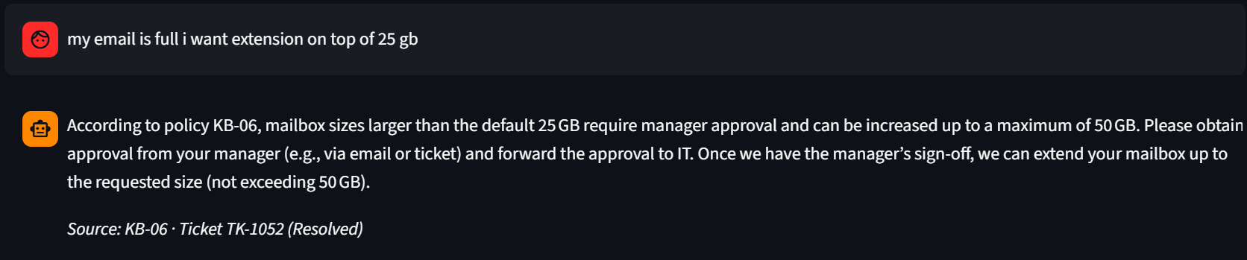
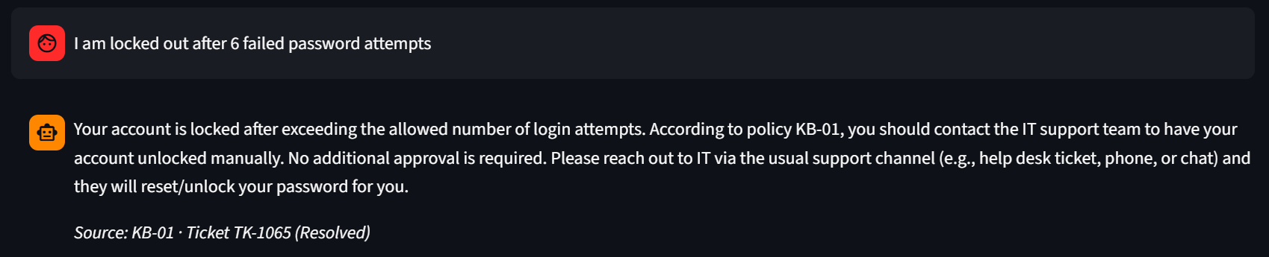
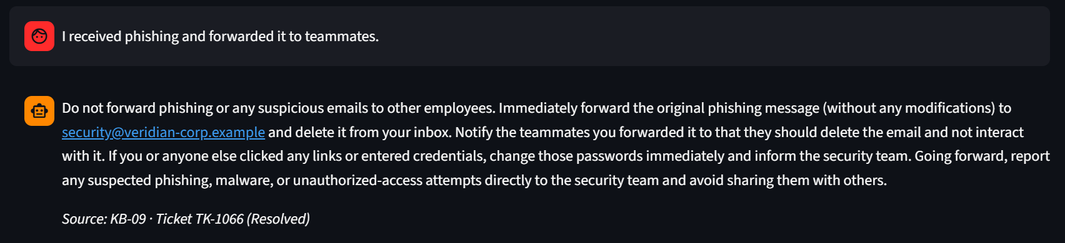
Demo Scenarios
AIONOS

Slide 7
AI Tools Used
AIONOS
  LLM (GPT-OSS-120B via Groq) : Understands employee queries in natural language
  Extracts relevant details from requests
  Helps decide between Resolve / Follow-up / Escalate
  AI-assisted Development: Used AI to accelerate coding and debugging
  Helped structure the LangGraph workflow
  Assisted with error identification and implementation
  Human-Controlled Logic: Policy mapping is controlled by the application
  Risk checks and ticket creation follow predefined rules
  AI does not invent company policies

Slide 8
AIONOS
Thank You For
Your Attention
PAGE 15

